Slide 1
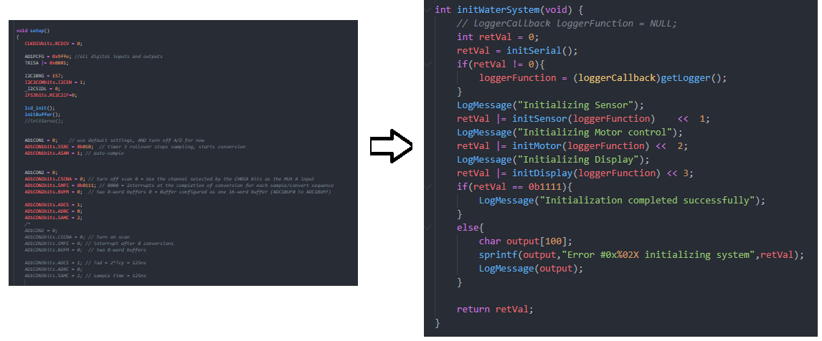
Converting to an API
By taking the individual components and separating them into their individual components.
Now each component can be used separately or as one controlled endpoint

Slide 2
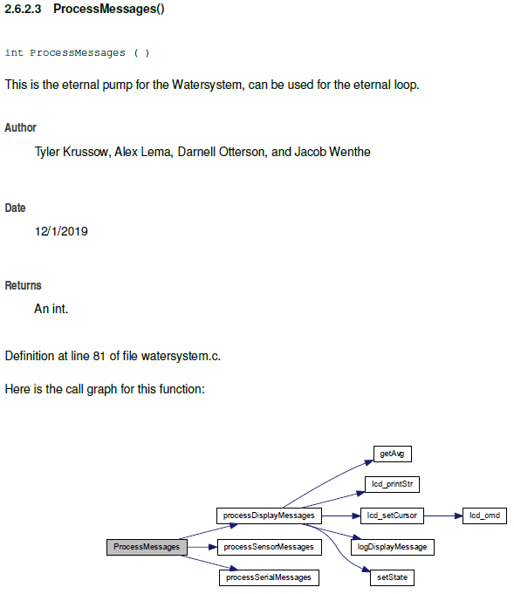
Auto-Docing
Tools:
Visual Studio
Atomineer
Doxygen
Latex
Process
Brief comments
Naming conventions
File formats
HTML documentation
PDF documentation

